Slide 1
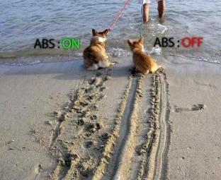
Automotive Vehicle Dynamics
Acceleration and Braking IV – Anti-Lock Braking
Sean Brennan
Department of Mechanical and Nuclear Engineering
Penn State University
sbrennan@psu.edu

Slide 2
First, a few words about spelling, since this is a pet peeve for the instructor
Breaking - separating or causing to separate into pieces as a result of a blow, shock, or strain.
Braking - making a moving vehicle slow down or stop by using a brake

Slide 3
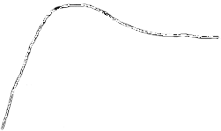
Wheel slip control is critical for directional stability
If the slip reached 100% (locked wheels) a loss of stability can occur. Even if stability is maintained, the forces generated from a locked wheel aren’t the maximum forces ⇒ longer stopping distance.
Ideally we want to operate at the slip that gives the peak force
F_{max}
F_{locked}
0
λ _{peak}
100%

Slide 4
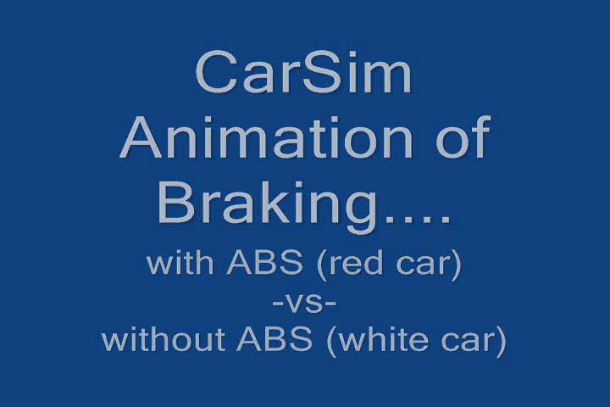
The difference in stopping distance is substantial

Slide 5
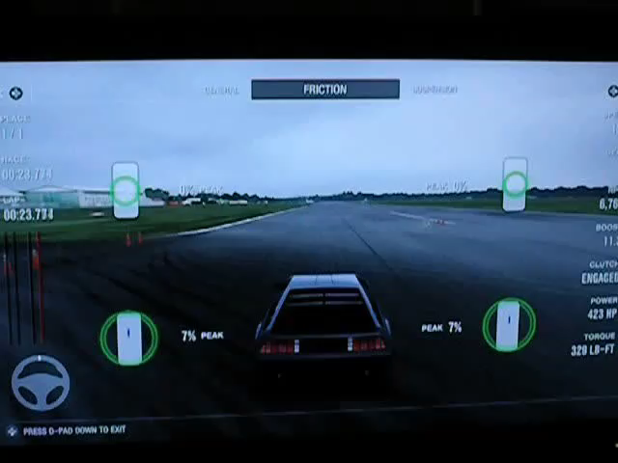
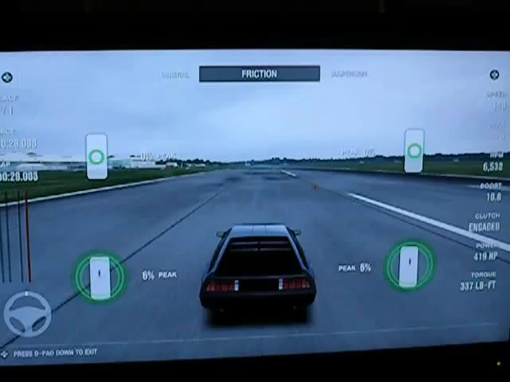
Anti-Lock Braking Systems: Stopping Times From 160-0 MPH
ABS (t=4.9s)
No ABS (t=5.5s)
*Take note of the skid mark patterns

Slide 6
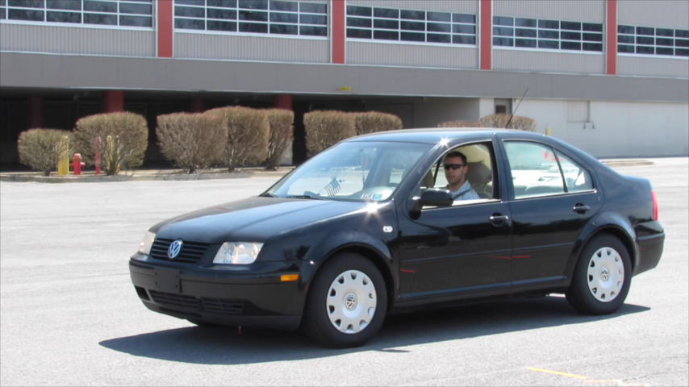
ABS also ensures that the tires continue to rotate, providing directional stability

Slide 7
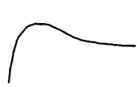
How do we stay at the peak?
For braking: Assume there’s a maximum allowable brake torque : τ_{max}
A simple control law to achieve peak slip is

Slide 8
Pure on-off may be a bad idea
However, this requires lots of things that are impossible: 1. Knowledge of what λ _{peak} is exactly. 2. Infinitely fast brake torque response.
A more realistic response involves the generation of a brake pressure which then generates a brake torque. (steady state τ_{brake} = K_{b} P_{brake}.)

Slide 9
The brakes cannot respond instantly
Let’s model the dynamics of the torque generation as a first order system.
where C_{fill} , C_{dump} are time constants of the fill and dump phases of the brake cylinder

Slide 10
And we may want to limit cycling
The brake system also has a hold phase where
but we won’t use that now.
Let’s treat P_{brake} as a constant supply pressure that’s regulated by an on-off solenoid valve.

Slide 11
So how do we implement?
K_{b} is a function of brake radius, brake pad friction coefficient, brake temperature and number of pads.
Now we could try the same strategy as before:
But we’d still need to know exactly where λ_{peak} was plus the solenoid valve would be constantly switching
Supply pressure

Slide 12
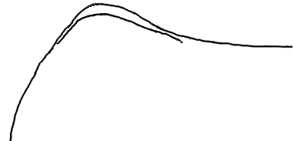
Putting it all together, we obtain a simple ABS strategy
Better idea:
This is a simple example of ABS for braking.
F_{x}
cycling
this is the
result.
λ_{min}
λ_{max}
100

Slide 13
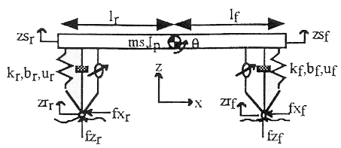
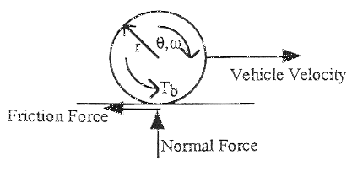
Simple Example
Half-car model with 2 wheel degrees of freedom.
4 DOF system

Slide 14
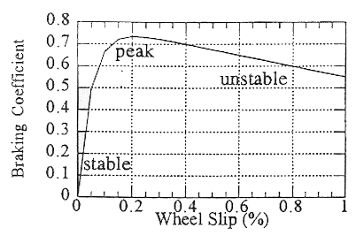
Simple Example
Braking Coefficient vs. Slip Curve

Slide 15
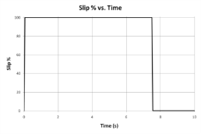
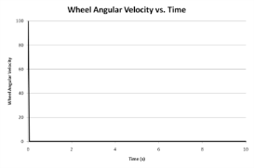
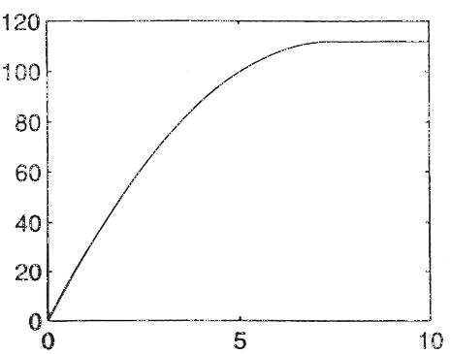
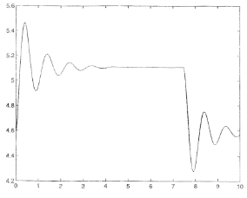
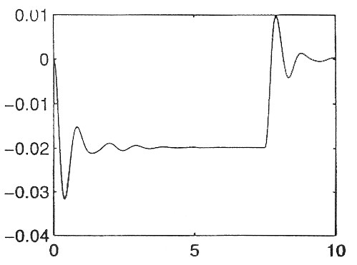
Without ABS Wheel Slip Control
Vehicle Pos.
Pitch ∠
Front normal force (kN)

Slide 16
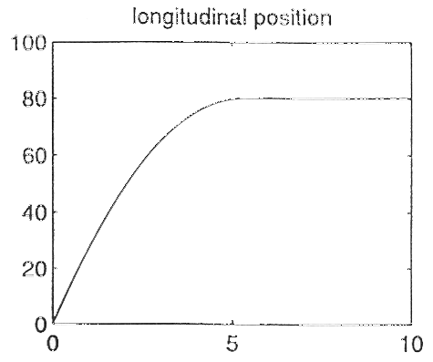
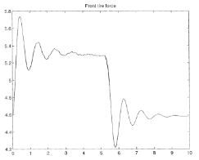
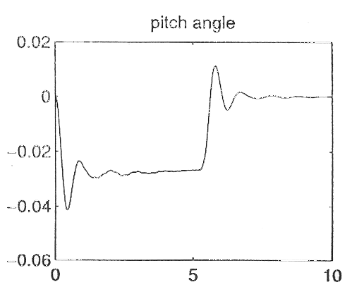
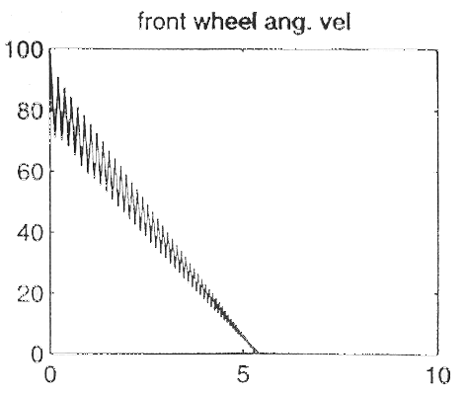
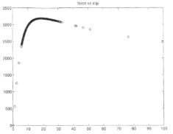
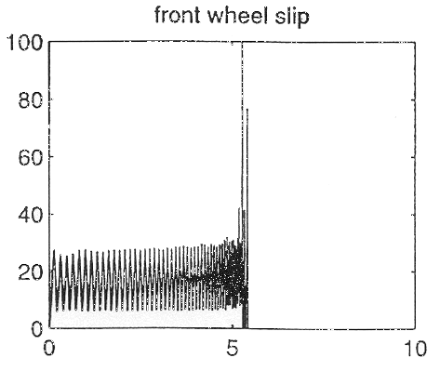
With ABS Wheel Slip Control
Front normal force (kN)
cycling

Slide 17
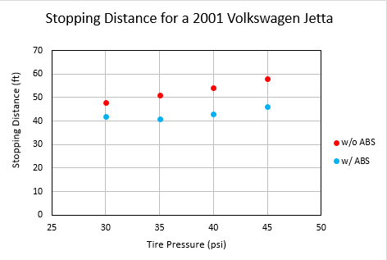
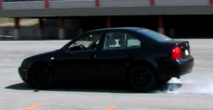
Student experiments (pulling ABS fuse to turn it off)
Initial Speed: 40 mph

Slide 18
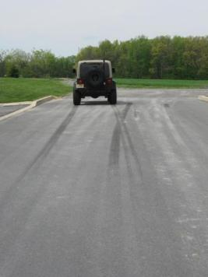
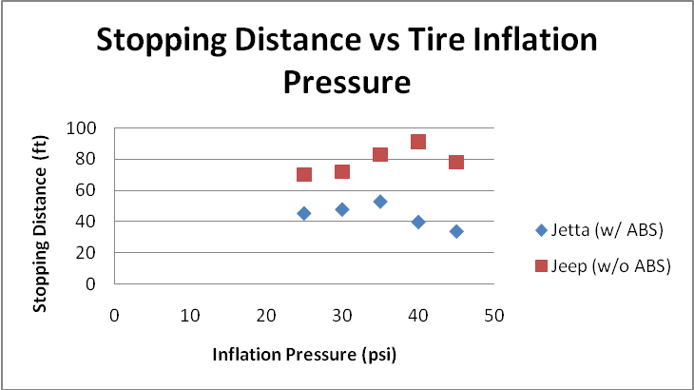
Distance depends on inflation pressure

Slide 19
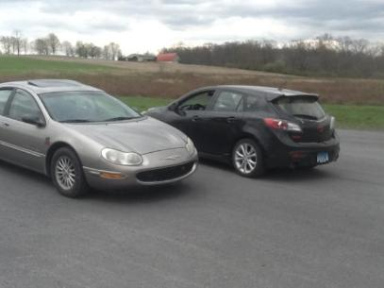
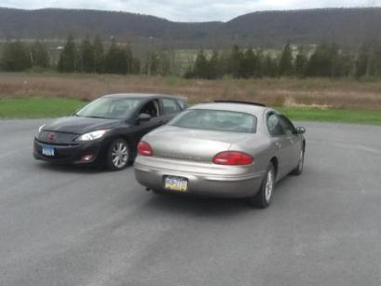
Case Study: Two vehicles were used to perform an experiment comparing ABS on vs off. Both vehicles have ABS, which can be disabled by removing a fuse.
Chrysler Concorde LXi
(Bright Platinum Metallic)
Mazda 3
(Black)

Slide 20
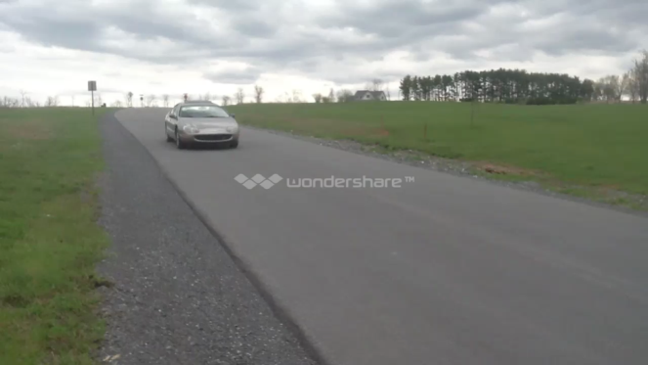
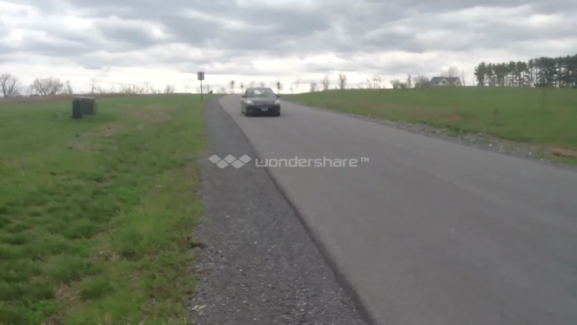
The test was performed on a road with 100ft of measured track. Each vehicle ran at 40mph with ABS.
Chrysler Concorde LXI
56ft
Mazda 3
50ft

Slide 21
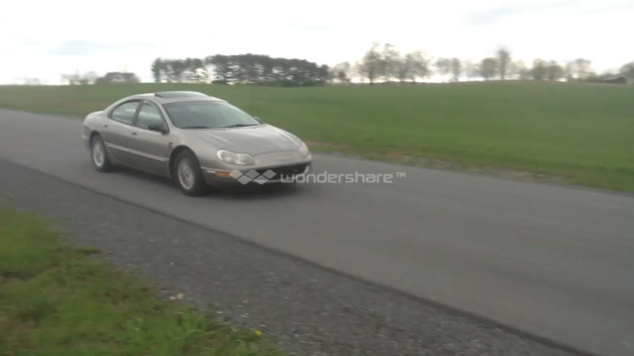
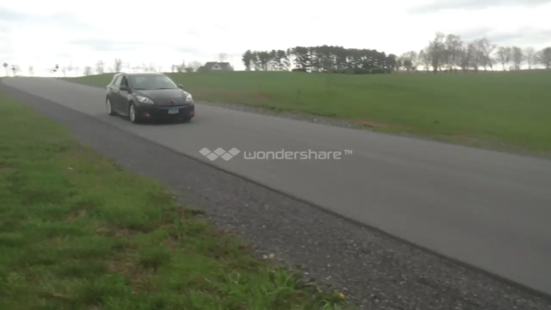
NO ABS 40MPH
Chrysler Concorde LXI
68ft
Mazda 3
64ft

Slide 22
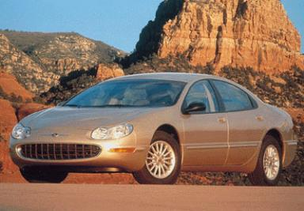
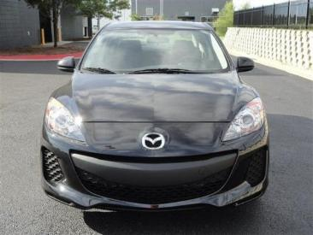
Final results yielded a 17.6% and 21.9% increase in performance for the Concorde and Mazda 3, respectively with ABS enabled
40MPH w/ABS: 56ft
40MPH No ABS: 68ft
40MPH w/ABS: 50ft
40MPH No ABS: 64ft

Slide 23
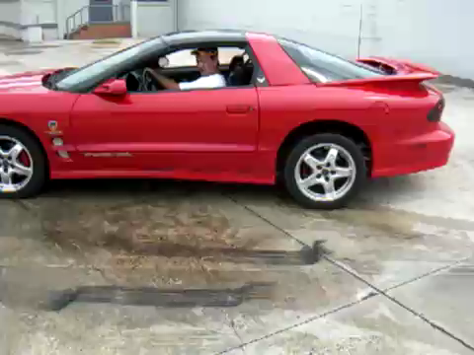
Traction control is like ABS, but for acceleration to prevent spin-out

Slide 24
Traction control systems are very like ABS
Very similar strategies can be used to minimize wheel slip during acceleration.
In this case, use τ_{accel} = Torque (1) λ < λ_{min} Torque (2) λ > λ_{max} τ_{accel} (t – Δt) λ_{min} < λ < λ_{max}
Torque (1) > Torque (2)

Slide 25
Traction control is different than ABS in that we can use other inputs
These two torques are generated from a variety of sources.
Torque (1) is principally engine torque x gear ratio and is governed by the throttle angle.
Throttle
angle
Engine
Nonlinear
Dynamics
τ_{engine}
Torque (1)
α

Slide 26
What other methods?
Torque (2) is a reduced torque that is obtained by one of several ways 1. Reduced throttle angle 2. Spark timing 3. Application of brakes.
The conceptual idea is the same as with ABS.

Slide 27
Hard problems in ABS and TCS?
What are some of the problems associated with ABS?
How do we know the velocity of vehicle with respect to ground? (without a ground speed sensor)
How do we determine road characteristics such as friction?

Slide 28
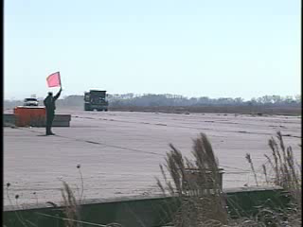
Finally, let’s talk about some vehicle testing situations
What are the ethical issues of this test?

